Slide 1


AIRLINE BOOKING MANAGEMENT SYSTEM

Slide 2

Team Members
1 | RA1911030010088 | Akshat Rawta | Lead
2 | RA1911030010089 | Yukta Goel | Member
3 | RA1911030010094 | Rahul Goel | Member

Slide 3
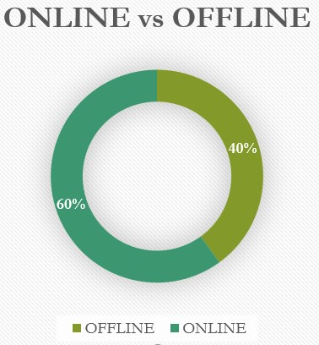
1.PROBLEM STATEMENT
Large Airlines have to deal with thousands of airline reservations every day which makes it challenging to manage these reservations and cancellation requests made by users. Thus arises the need for an application based on a powerful database management system. The aim of this project is to create an Airline Booking Management System which will hold flight schedules and its fare tariffs and passenger reservations. It saves time as it allows online procedure as users no longer to wait in a queue to book the flights. It is automatically generated by the server. Admin is the main authority who can perform addition, deletion, and modification of flights if required. The admin will also be able to view passenger reservations of the flights. The users will be able to view all flight related information online and will be able to make cancellation requests effortlessly.

Slide 4
2.REQUIREMENTS
Interface Requirements
Functional Requirements
Non-Functional Requirements
Infrastructure Requirements
Skills Required

Slide 5
1.Interface requirements: The user and the company correlate things through the website interface and this website interface have two further subsystems:
• Supplier Subsystem This interface functioned by the company in initialising services, manage data, update and modify recommendation algorithms, display flight schedule and availability etc with all the user’s requirements.
• User Subsystem This subsystem is for customers, here all the credentials of the user will be accessed through this. User can create an account in correspondence with the company’s requirement. All other users activities are done through this.
2. Functional Requirements
• Client
Through the client interface the company gathers information related to airline activities, location, yearly flight course pattern etc to give the best recommendation and suggestions to ensure booking with best feature, economically. Popping up the flights schedule in an organised order accordingly. Ensuring data privacy and guaranty, activities being exposed rather than the company fulfilling users requirement will be ensured.
• Server
The server-side system will hold the entire data in a graph database, and must include all functionality to perform operations on this database, receive requests from the clients, evaluate, create and send recommendations etc.
3.Non-functional Requirements
This includes performance requirements.
• Accuracy • Security • Transparency

Slide 6
4.REQUIRED SKILLS
Skills | More Info
UX Designer | Designing experience of user
Frontend Development | Design and Develop UI and frontend layer
Backend Development | Design Database and Develop Service / API
Testing | Develop Test Cases
Project Management | Project Planning, Scheduling, Executing, Monitoring and Controlling
5.Infrastructure Requirements
Requirement (#) | Requirement Specification | Department | Project Team Member
IR1 | Development Machine with atleast 12GB RAM and intel i5 or equivalent processor. | Software Dept. | Pranav Srivatsav
IR2 | Code Repository | Software Dept. | Raj Pratap Singh
IR3 | AWS S3 Bucket | Software Dept. | Pranav Srivatsav
IR4 | IDE – VS Code | Software Dept. | Shoibam Amritraj

Slide 7
Constraints
S.No | Category | Constraints
1. | Language | The website will be designed in English to expand the reach and engagement so knowing English is a must. Coming to system language we need a commonly used programming language.
2. | Hardware Constraints | User need to have a system that can be laptop, PC, tablet etc which supports our application.
3. | Usability | The software will be embedded in a website. It should be scalable designed to be easily adopted by a system.
4. | Reliability | The system should have accurate results and fast responses to user’s changing habits.
5. | Security | Ensuring a tight, healthy interface is one of the major concern.

Slide 8
3.Design
User Case Diagram
Level 1 Diagram
Class Diagram
Collaboration Diagram
Deployment Diagram

Slide 9
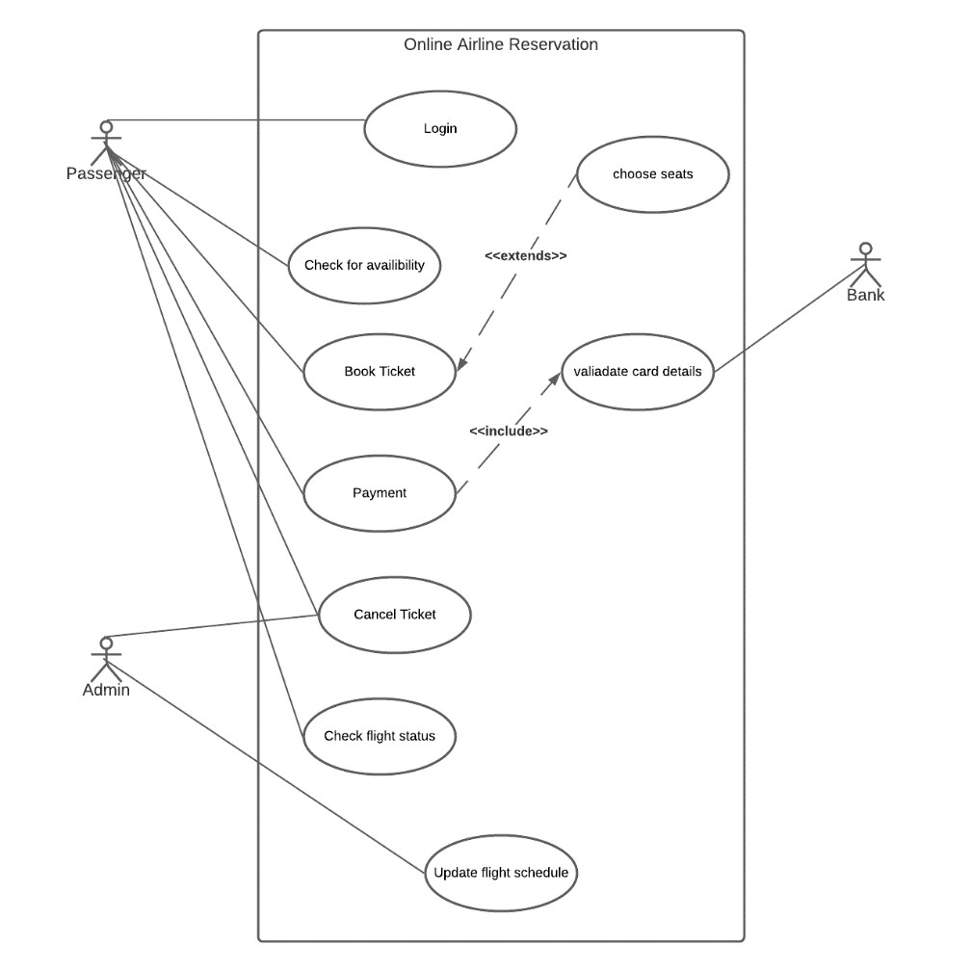
User Case Diagram

Slide 10
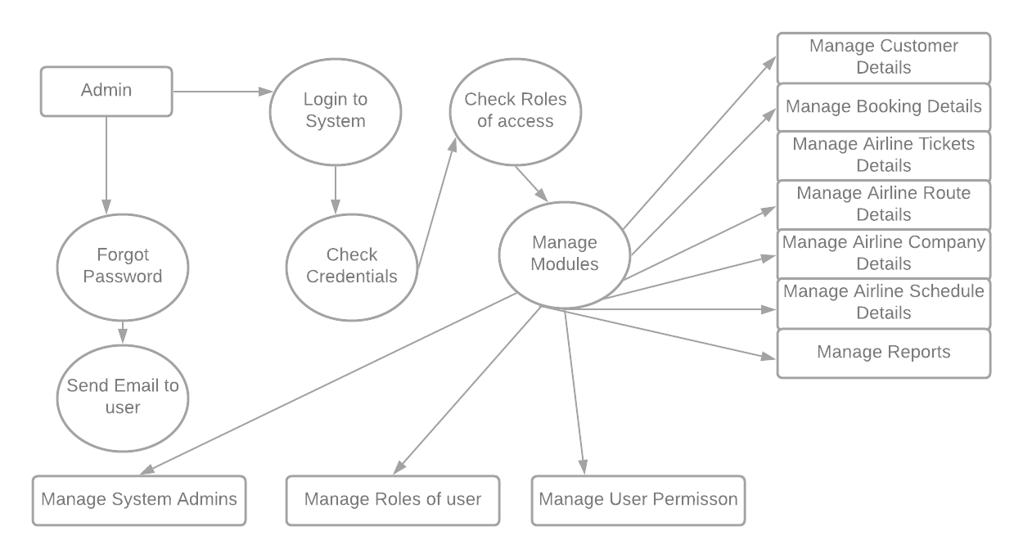
LEVEL 1 DIAGRAM

Slide 11
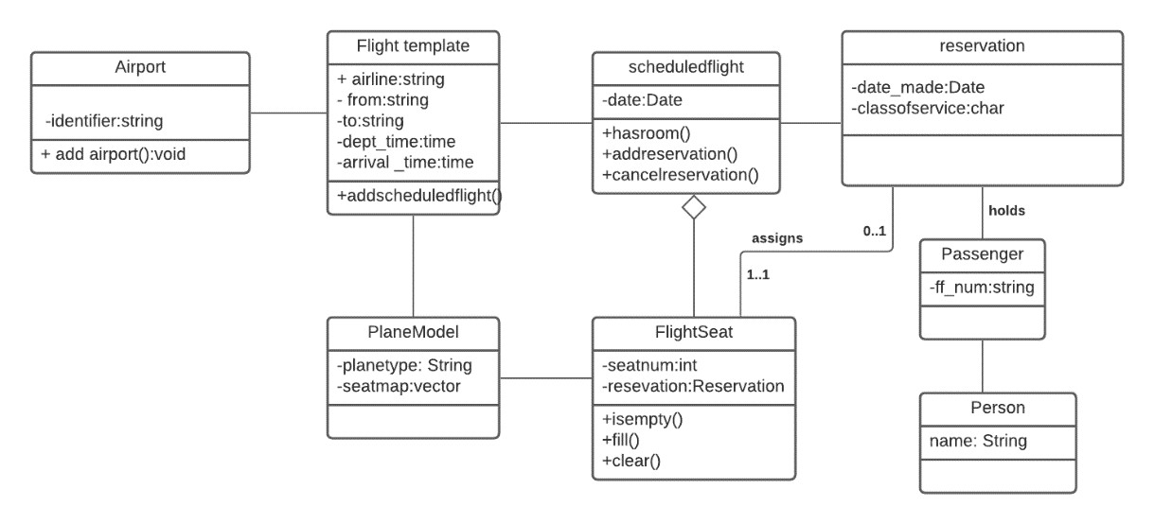
Class Diagram

Slide 12
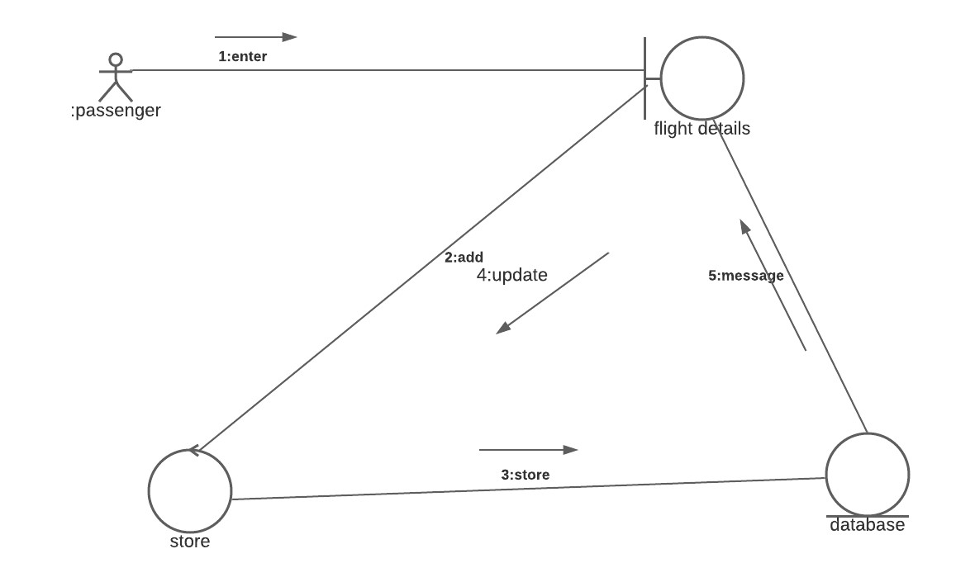
Collaboration Diagram

Slide 13
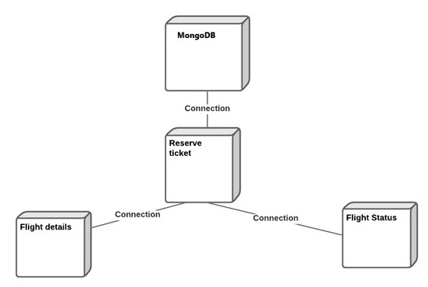
Deployment Diagram

Slide 14
4.Modules
Module 1 – LOGIN/SIGN UP
Module 2 – BOOKING PAGE
Module 2 – CANCELLATION PAGE

Slide 15
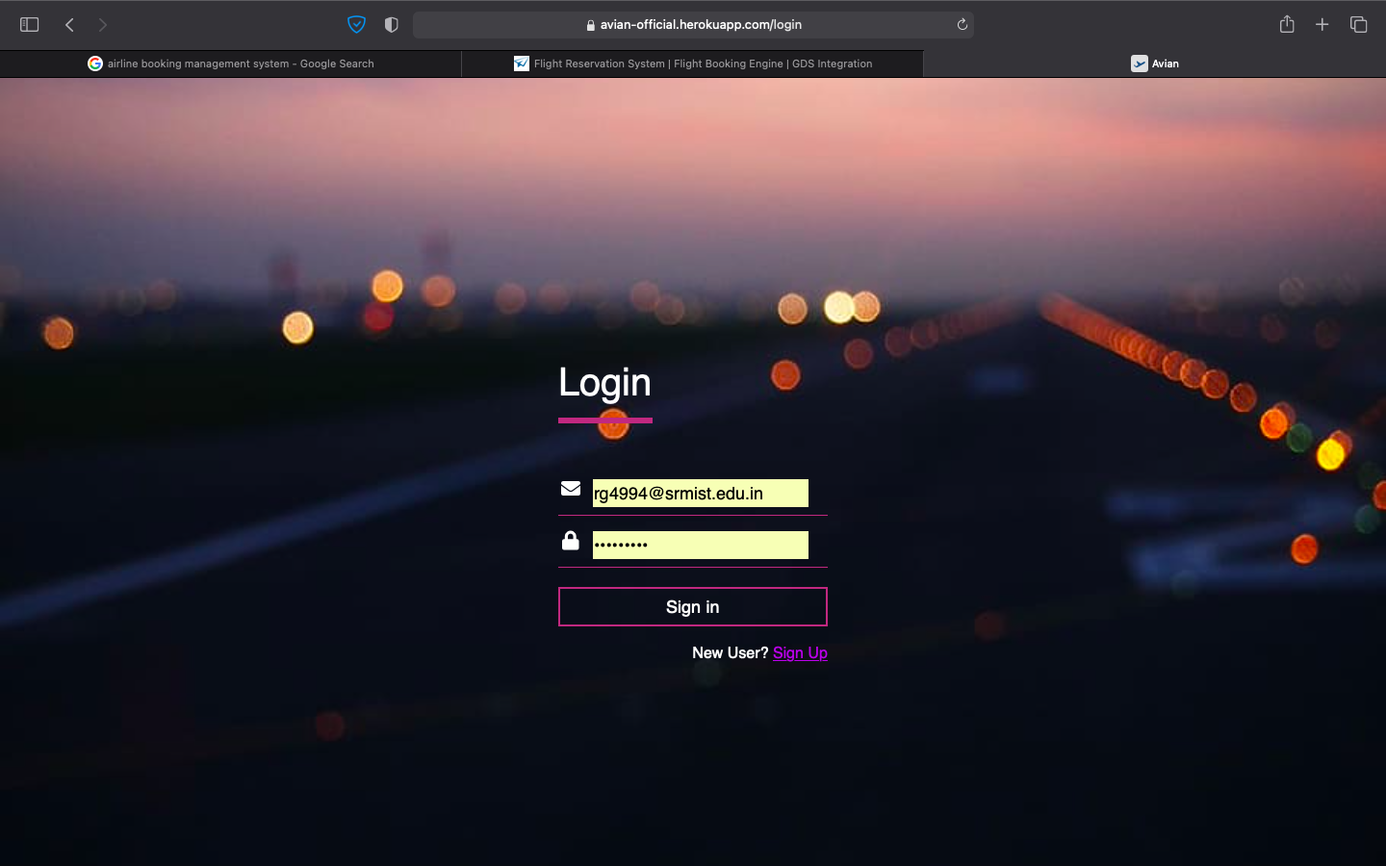
Module 1 – LOGIN

Slide 16
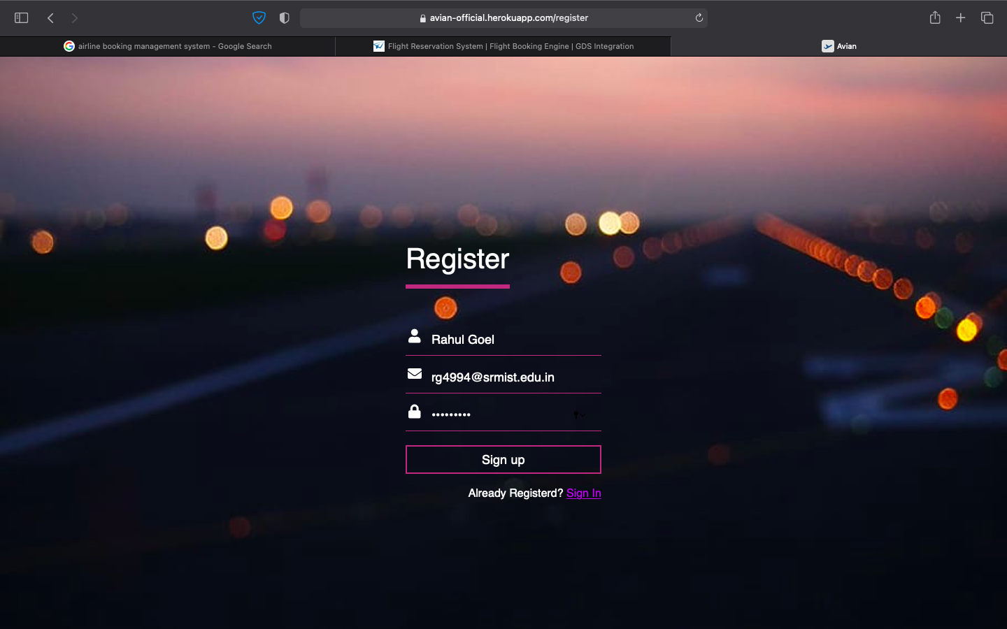
Module 1 - SIGN UP

Slide 17
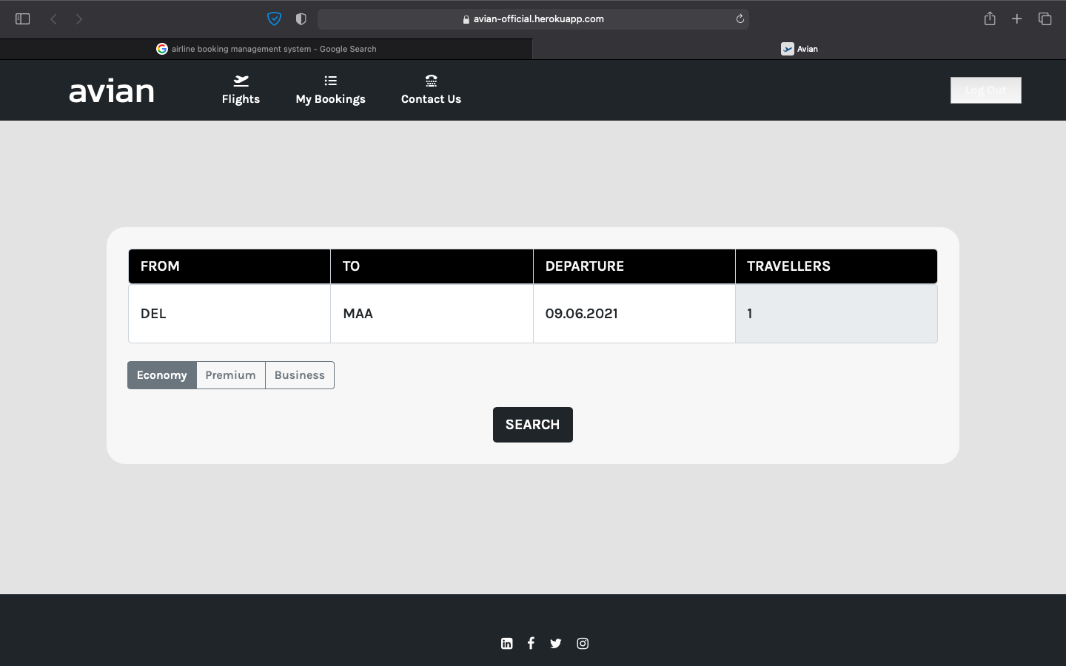
Module 2 – BOOKING PAGE

Slide 18
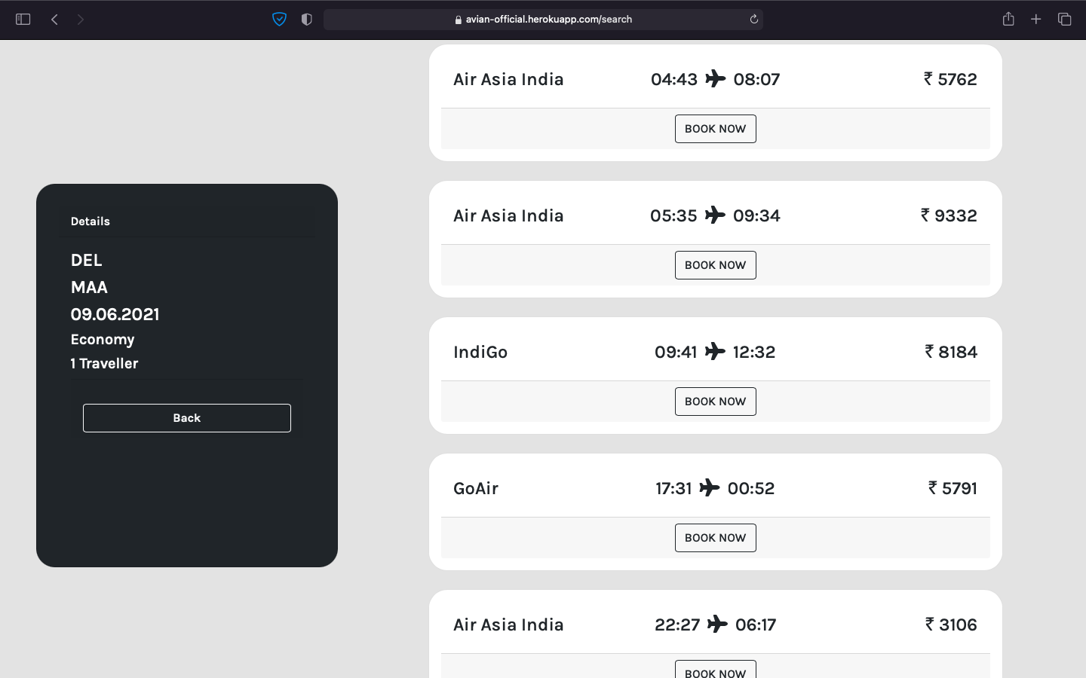

Slide 19
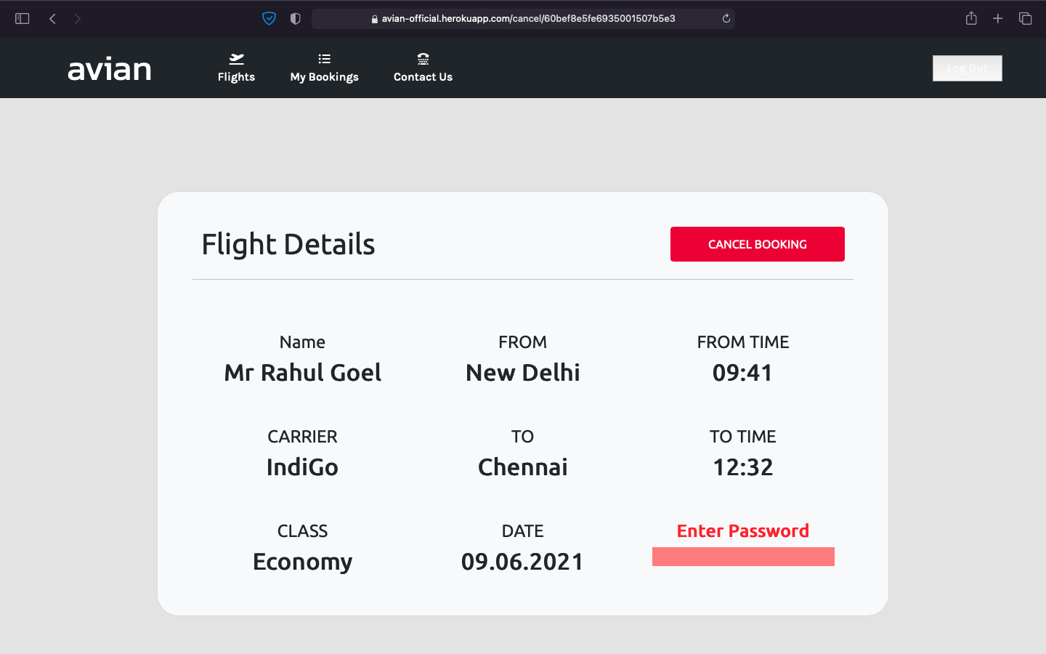
Module 2 – CANCELLATION PAGE

Slide 20
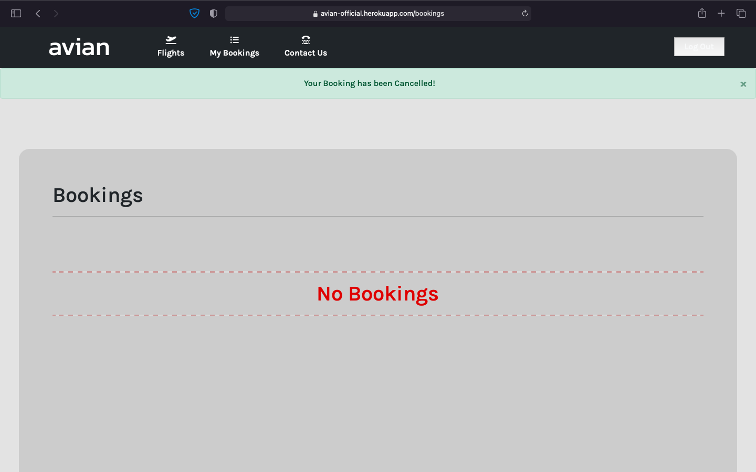

Slide 21
TEST CASES
Login page
Registration page
Main page
Booking page

Slide 22
LOGIN PAGE:
S.NO | TEST CASE | RESULT | TEST
1. | On the click of login button | The user should be logged into the site if the username and password match. Else the user should be denied access. | successful
2. | On the click of register button | The user should be taken to the registration page. | successful
REGISTRAION PAGE:
S.NO | TEST CASE | RESULT | TEST
1. | On the click of register button | The user along with all the other user information should be added to the database. | successful

Slide 23
MAIN PAGE:
S.NO | TEST CASE | RESULT | TEST
1. | On the click of book tickets button. | The user should be taken to ticket booking page. | successful
2. | On the click of cancel ticket button | The ticket booked by the user should be cancelled. | successful
3. | On the click of logout button | The user should be logged out of the site and session should be destroyed. | successful
BOOKING PAGE:
S.NO | TEST CASE | RESULT | TEST
1. | On the click of book button | The user’s ticket should be booked. | successful
2. | On the click of cancel button | The user should be taken back to the main page. | successful

Slide 24

THANK YOU
Website Link: -
https://avian-official.herokuapp.com

